Slide 1
Hearing Aid Care, Maintenance, sanitization at home during lockdown
समेकित क्षेत्रीय कौशल विकास, पुनर्वास एवं दिव्यांगजन सशक्तिकरण केंद्र, नागपुर COMPOSITE REGIONAL CENTRE FOR SKILL DEVELOPMENT, REHABILITATION & EMPOWERMENT OF PERSONS WITH DISABILITIES, NAGPUR (Under Administrative Control of National Institute for Empowerment of Persons with Multiple Disabilities) (Department of Empowerment of Persons with Disabilities (Divyangjan), Ministry of Social Justice & Empowerment, Govt. of India) Krida Prabodhini Hall, Yashwant Stadium, Dhantoli, Nagpur-440012 (Maharashtra) Tel. No. 0712-2445439 Email: nagpurcrc@gmail.com

Slide 2
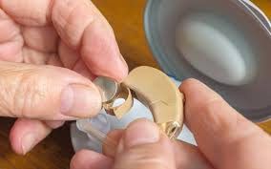
Daily Maintenance of hearing aids
Hearing aids help those with auditory problems hear the world around them. But just like any other investment, these devices require special maintenance and care to ensure they continue working properly.
care and maintenance to prolong the life of the hearing aids and keep them working properly. Each day, perform the following maintenance tasks:
Inspect the hearing aid parts for breaks, cracks and other signs of damage.
Analyse the earmold and tube for earwax or moisture damage.
Use your blower to remove earwax build-up, and be sure to place your aids in a drying container in between uses.
check the batteries. Use a battery tester to assess the performance of batteries.
To evaluate the lifespan of batteries, you can place a sticker on the calendar indicating the day on which you changed the batteries of your hearing aid.

Slide 3
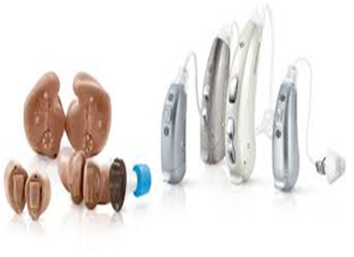
Cleaning Your Hearing Aids
From ear wax to moisture vapours, hearing aids are susceptible to the accumulation of liquid and solid substances that can stop them from working properly. It is important to ensure that your hearing aids are kept clean at all times. Here are some tips:
You can clean the hearing aid by using Kleenex, wipes or a towel.
Take care not to wipe anything onto the tubing of the hearing aid.
When not in use, disconnect the hearing aid by opening the battery case door.
Store the hearing aid in a dry kit to prevent accumulation of moisture.
Do not attempt to repair the device on your own.

Slide 4
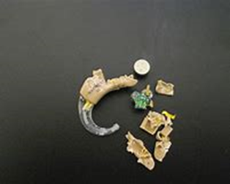
Avoiding Physical Damage
Physical damage can cause your hearing aids to stop working properly. Severe damage may require repairs or complete replacement.
Always store your aids in their case when not in use.
Make sure your aids are out of reach of pets and small children at all times.
If damage does occur, make an appointment with your audiologist as soon as possible.
If the case becomes damaged, do not wear your aids. The sharp edges could cause irritation or abrasion to the ear.

Slide 5
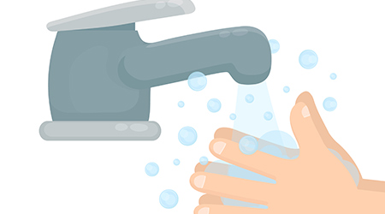
How to sanitize hearing aids
Wash your hands thoroughly with soap and warm water before and after sanitizing your hearing aids.
Brush off your hearing aids using a toothbrush or other fine brush to remove wax.
After the wax is removed, finish with gently wiping down the exterior of the device. Hearing professionals recommend using alcohol wipes or bleach wipes, as these products will not damage the aid.
Do not wipe down internal parts or the battery section.
Let the hearing aids air dry before placing back in your ears.
Wash your hands thoroughly with soap and warm water.

Slide 6
 | समेकित क्षेत्रीय कौशल विकास, पुनर्वास एवं दिव्यांगजन सशक्तिकरण केंद्र, नागपुर COMPOSITE REGIONAL CENTRE FOR SKILL DEVELOPMENT, REHABILITATION & EMPOWERMENT OF PERSONS WITH DISABILITIES, NAGPUR (Under Administrative Control of National Institute for Empowerment of Persons with Multiple Disabilities) (Department of Empowerment of Persons with Disabilities (Divyangjan), Ministry of Social Justice & Empowerment, Govt. of India) Krida Prabodhini Hall, Yashwant Stadium, Dhantoli, Nagpur-440012 (Maharashtra) Tel. No. 0712-2445439 Email: nagpurcrc@gmail.com
For any Queries & Details, feel free to contact:
Prafull Shinde (Assistant Professor – Speech & Hearing)
Department Of speech & Hearing
CRC – Nagpur
contact : 0712-2445439
Mobile : 9890763885

